Slide 1
Ingenu To Azure
Bridging the gap between Ingenu’s RMPA network and Microsoft Azure
https://aka.ms/ingenu2azure • https://aka.ms/ingenu2azurecasestudy

Slide 2
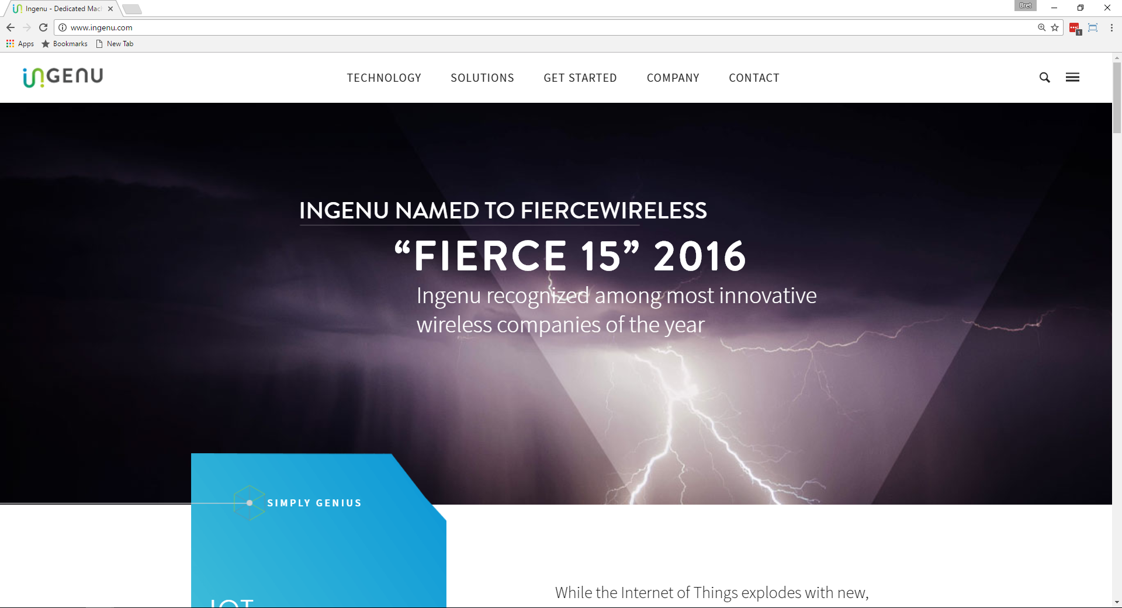
Ingenu & rpma
www.ingenu.com

Slide 3
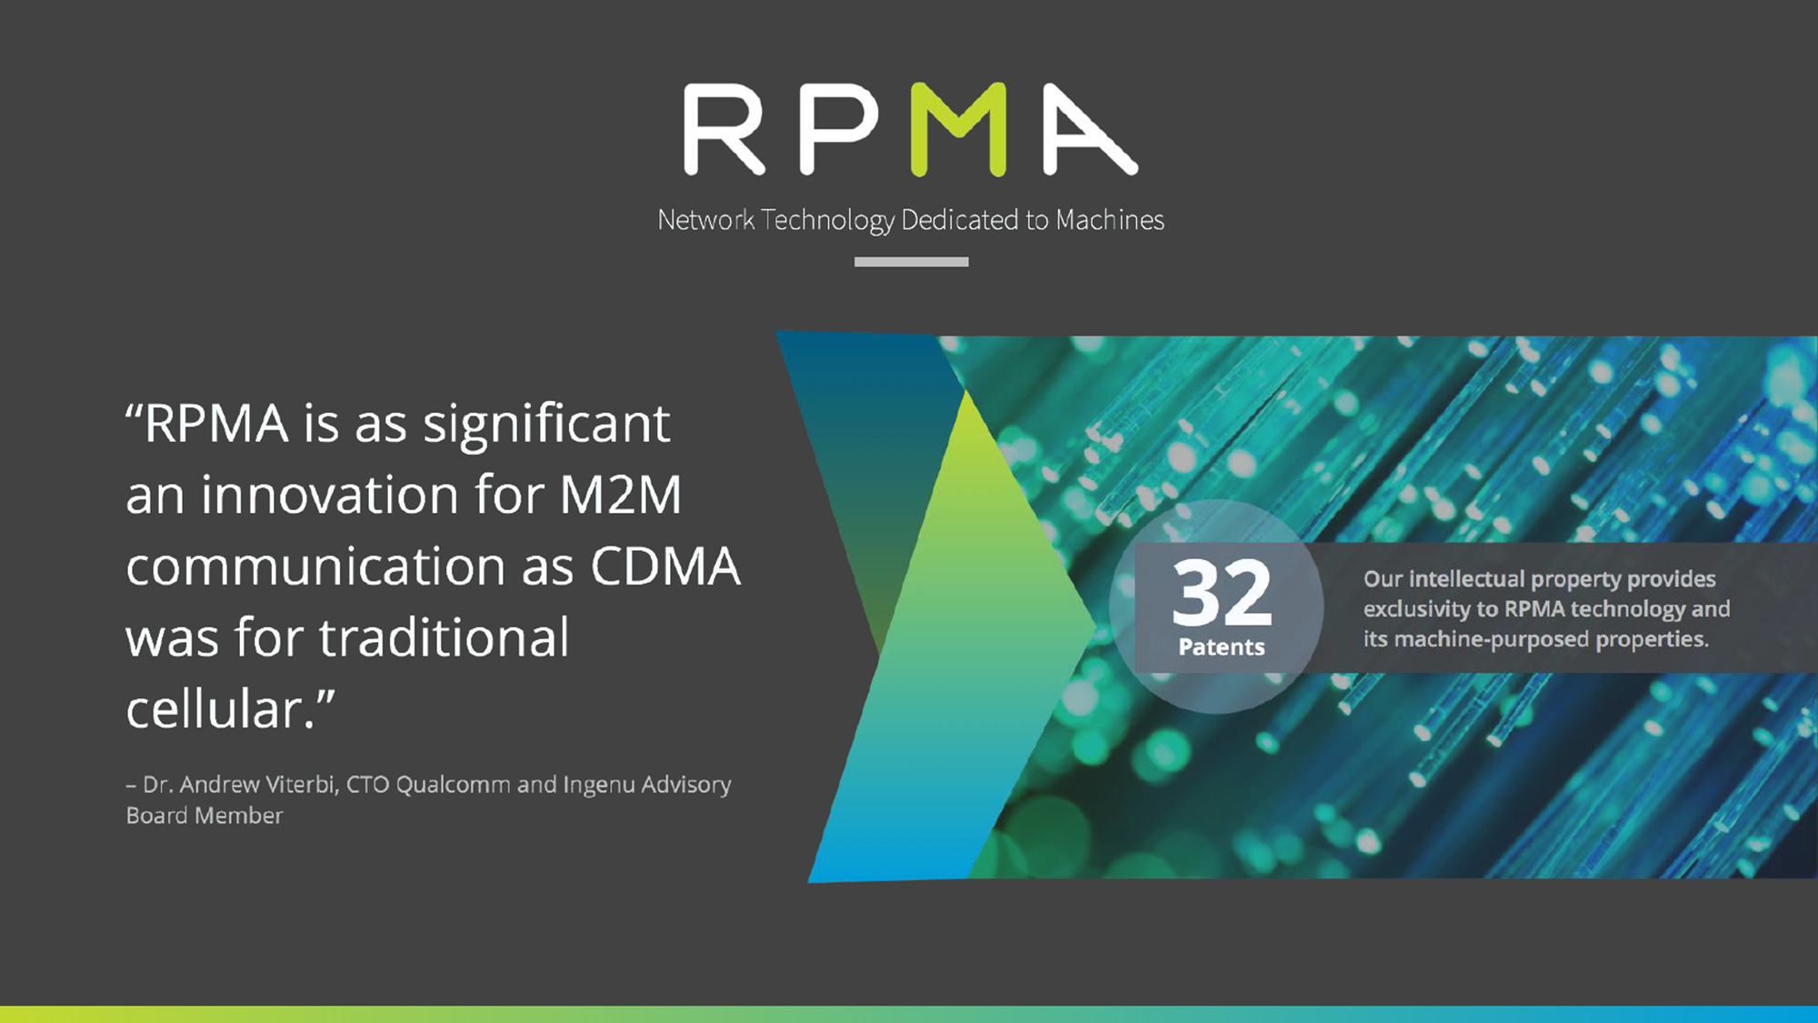

Slide 4
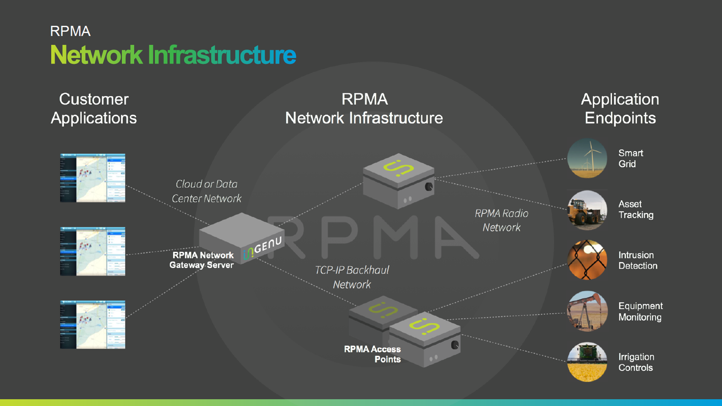

Slide 5
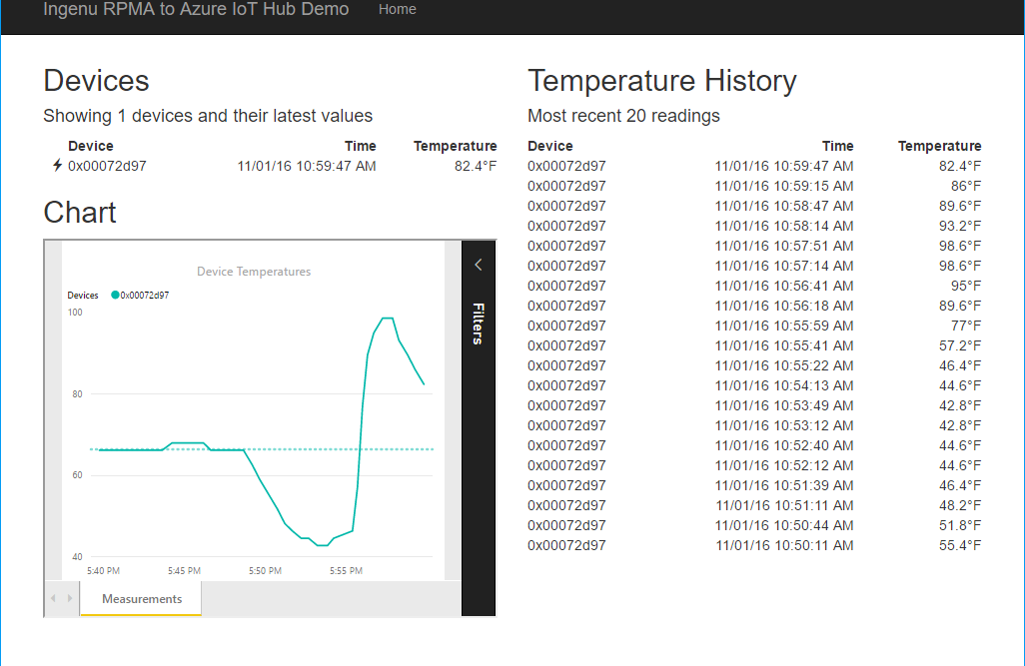


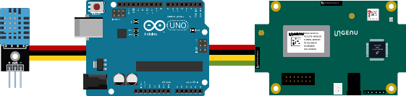
Resource Group ingenugroup
Power BI Embedded Collection ingenucollection
Power BI Embedded Workspace Dynamic GUID
RENDER
Power BI Report Temperature Chart
Storage Account ingenustorage
App Service Plan ingenuplan
READ/WRITE
Function App ingenufunctions
GET
Web App ingenuweb
QUERY
Function EventHub2IntellectRestJS
Function IntellectRest2IoTHubJs
QUERY
Service Bus Namespace ingenubus
SQL Server ingenusql
RECEIVE
SQL Database
ingenudb
Event Hub
ingenualerts
SEND
OUTPUT
OUTPUT
Stream Analytics Job ingenujob
POST
GET
AZURE
INPUT
RPMA to Azure
Architecture Diagram
IoT Hub ingenuhub
Ingenu Intellect Platform - REST or AMQP
INGENU
BACKHAUL
Ingenu RPMA Access Point
UPLINK
DOWNLINK
FIELD

Slide 6
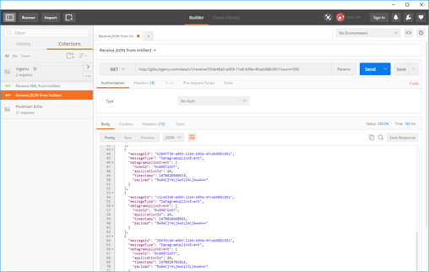
GET
AZURE
RPMA to Azure
Architecture Diagram
Ingenu Intellect Platform - REST or AMQP
INGENU
BACKHAUL
Ingenu RPMA Access Point
UPLINK
FIELD

Slide 7
Resource Group ingenugroup
Power BI Embedded Collection ingenucollection
Power BI Embedded Workspace Dynamic GUID
RENDER
Power BI Report Temperature Chart
Storage Account ingenustorage
App Service Plan ingenuplan
READ/WRITE
Function App ingenufunctions
GET
Web App ingenuweb
QUERY
Function EventHub2IntellectRestJS
Function IntellectRest2IoTHubJs
QUERY
Service Bus Namespace ingenubus
SQL Server ingenusql
RECEIVE
SQL Database
ingenudb
Event Hub
ingenualerts
SEND
OUTPUT
OUTPUT
Stream Analytics Job ingenujob
POST
GET
AZURE
INPUT
RPMA to Azure
Architecture Diagram
IoT Hub ingenuhub
Ingenu Intellect Platform - REST or AMQP
INGENU
BACKHAUL
Ingenu RPMA Access Point
UPLINK
DOWNLINK
FIELD

Slide 8
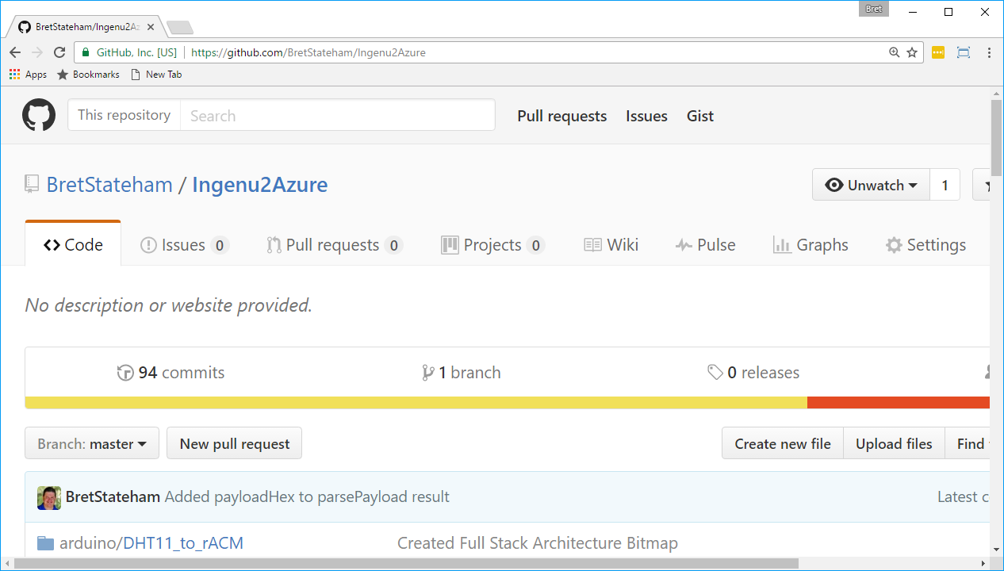
Source code & slides
http://aka.ms/ingenu2azure

Slide 9
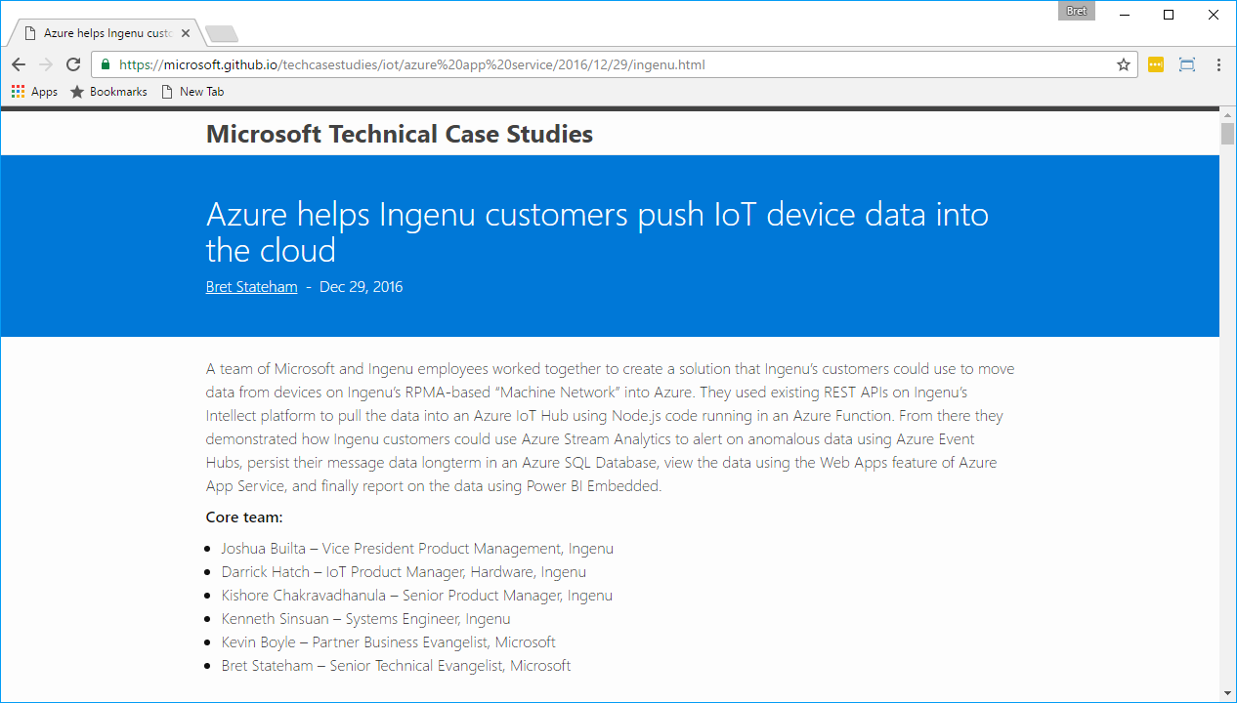
Technical case study
https://aka.ms/ingenu2azurecasestudy

